Slide 1
Windows 10 Lighting up your UI
Daren May
Windows Development MVP

Slide 2
What phone do you have in your pocket?

Slide 3
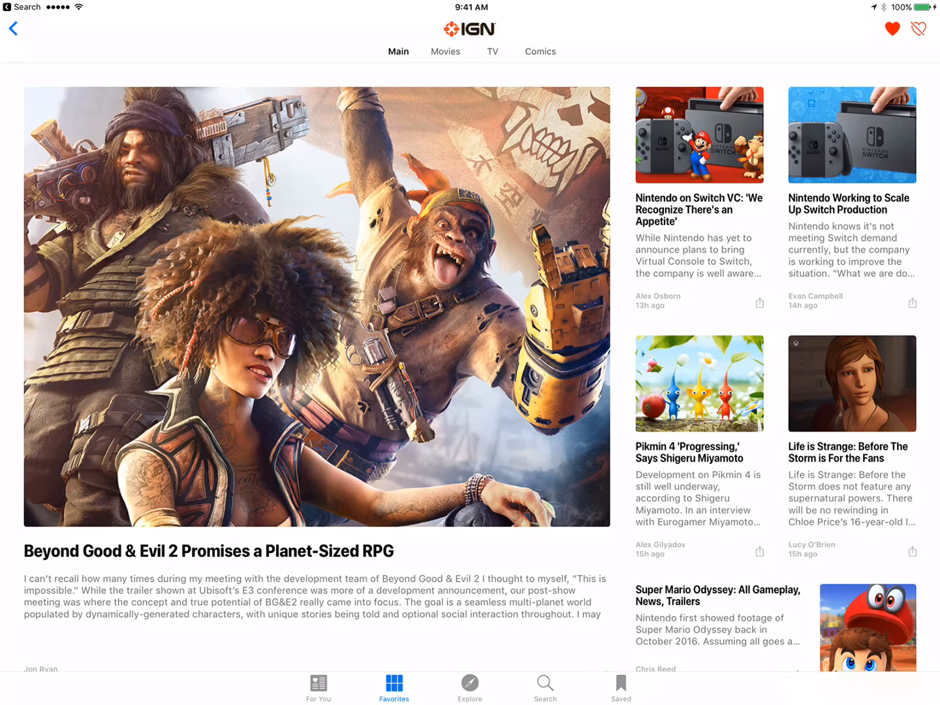
iOS News

Slide 4
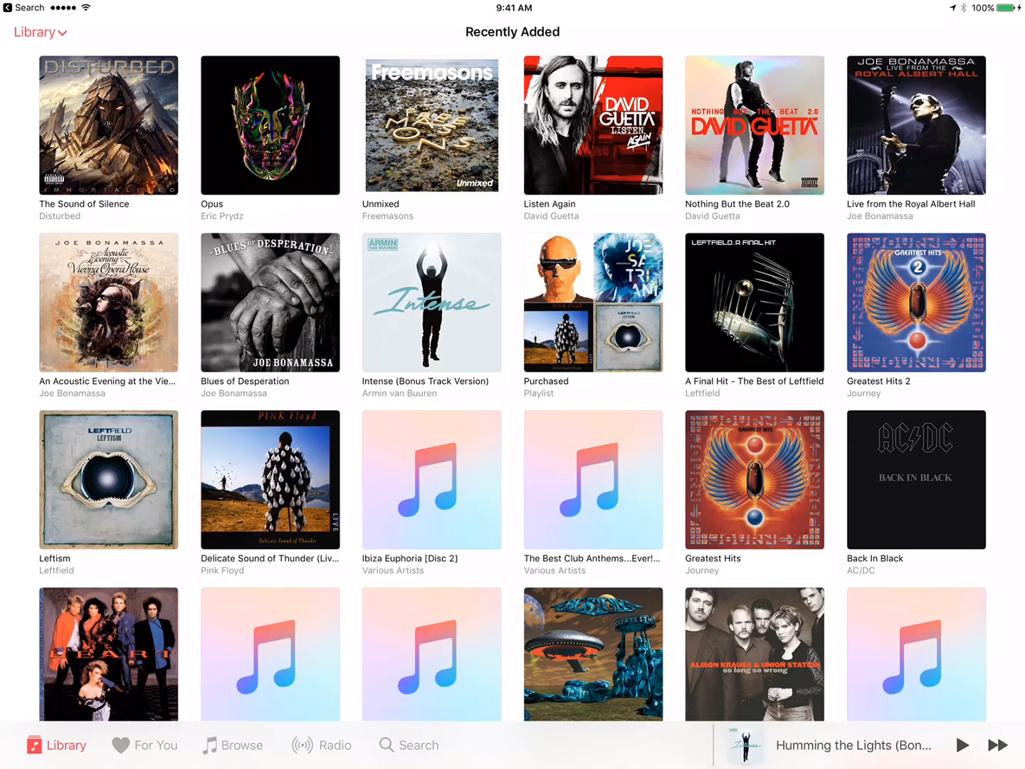
iOS Music

Slide 5
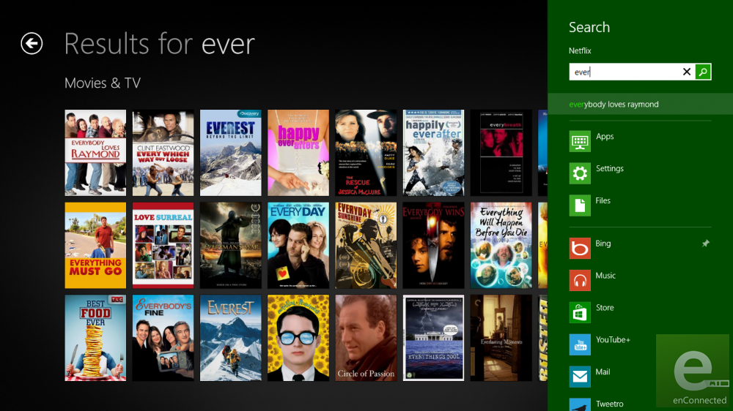
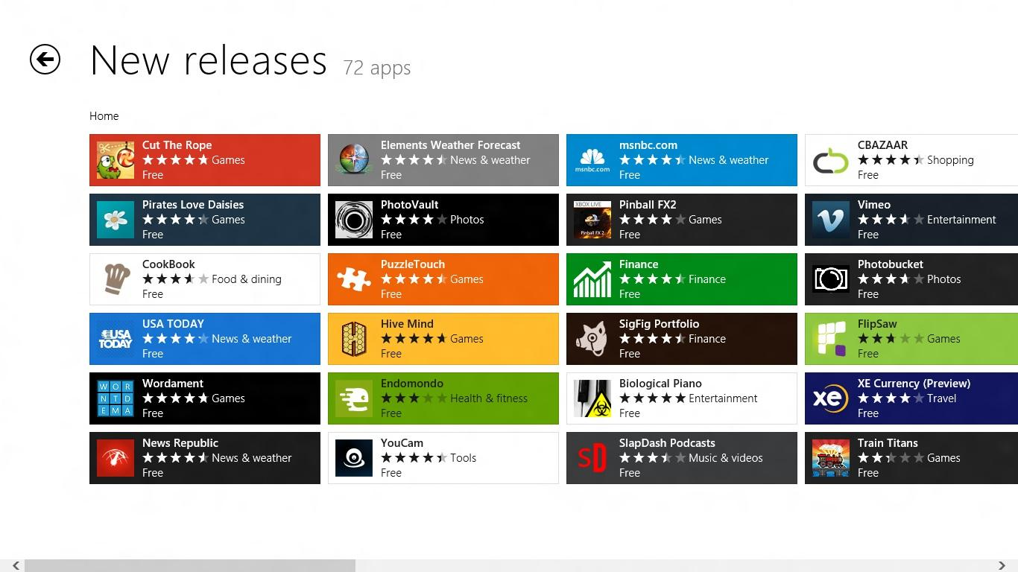
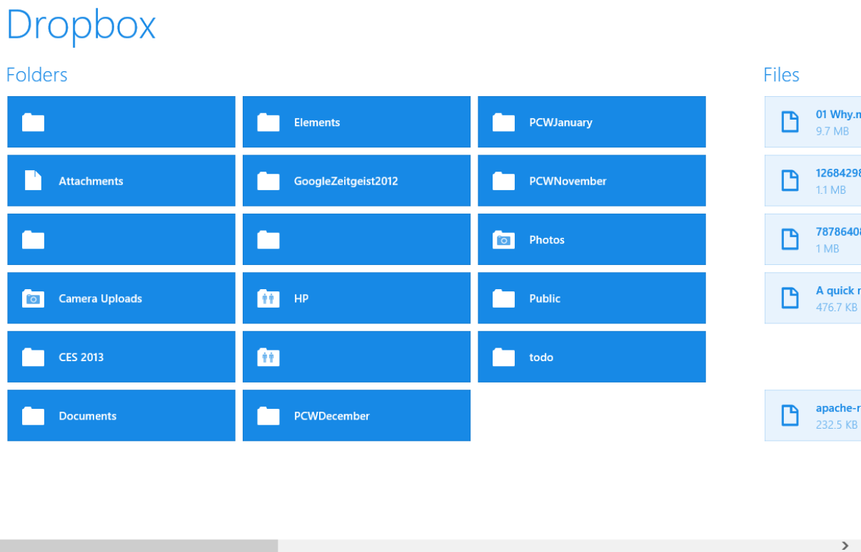
Windows 8 Store Apps…

Slide 6
Uninspiring!

Slide 7

So what next?

